Slide 1
Chessington
Ward Panel Meeting
27th July 2022

Slide 2
Introductions
Sergeant Henderson
Hook & Chessington North Team
PC Foley
PC Kerr
PCSO Arafat
Chessington South & Malden Rushett Team
PC Wright
PCSO Al-Hakem

Slide 3
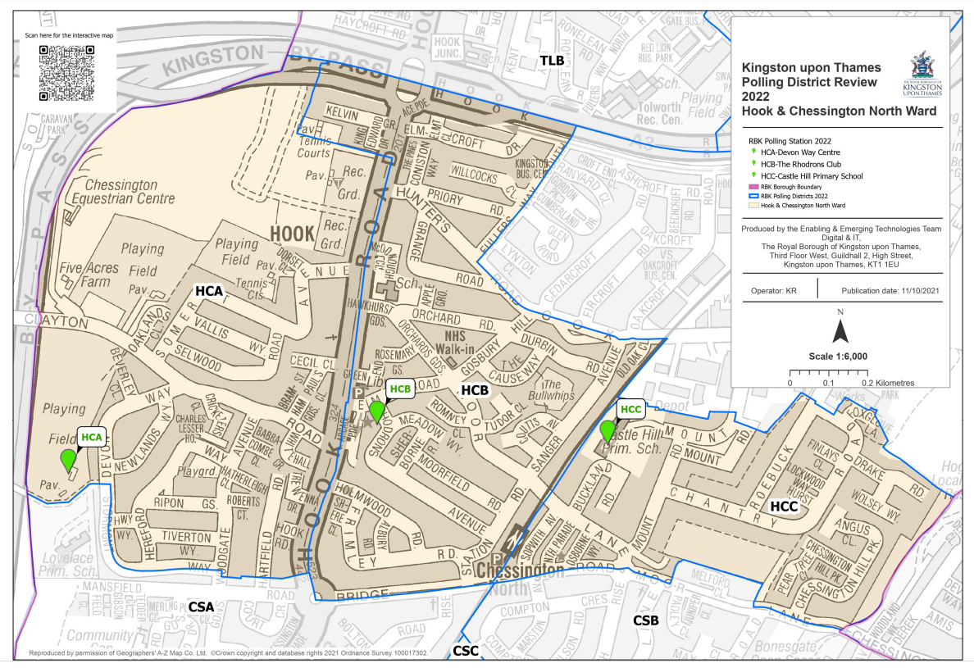
Ward boundary updates: Hook & Chessington North

Slide 4
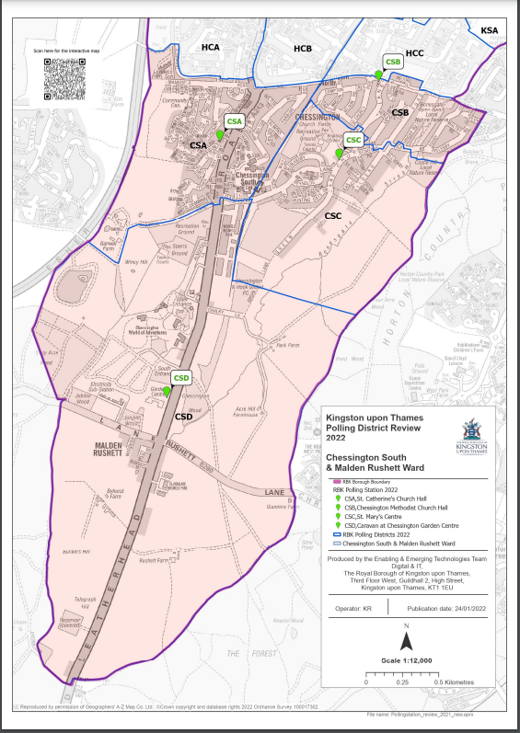
Ward boundary updates: Chessington South & Malden Rushett

Slide 5
3 month overview
Period between May 2022 to present had 256 crimes across both wards.
May 2022 - 104 crimes
June 2022 - 96 crimes
July 2022 – 56 crimes

Slide 6
Notable events
Start of street-a-week initiative
Engagements at local groups such as women's institute, St Paul's Church
Security week with staff at Chessington World of Adventures, resulting in arrest
County lines arrest
Speedwatch

Slide 7
Drug offences
12/05 - Roebuck Road – poss cannabis – outcome com res
210/6 - Bransby Road – poss cannabis – outcome com res
22/06 Leatherhead Road – PWITS class B – arrested – still investigating
24/06 Hereford Way – poss cannabis – outcome charged for poss of cannabis (already has suspended sentence for PWITS)
22/07 - Bullwhips Park – poss cannabis - outcome PND

Slide 8
Burglaries
09/05 - Chantry Road – entry method unknown – 2 rings, disabled parking permit stolen
11/05 - Lion Park Avenue - climbed scaffolding then wedged a window open – 1 power tool stolen
13/05 - Rollesby Road – Lock to garage door chiselled – Power tool stolen
18/05 - Bridge Road – Entered through the window – 2 laptops, 1 phone, 1 vape and £450 cash stolen
31/05 - Elwy House, Hall Gardens - entry method unknown – 2 electric scooter stolen – used bolt cutters to break the chains

Slide 9
03/06 - West Road – Garage broken into – Bike frame hybrid stolen
03/07 - Harrow Close - Mail going missing from communal area
07/07 - Leatherhead Road – Porch Door left unlocked – shoes stolen
14/07 - Sopwith Avenue – Locked with a chain under a communal stairway - 2 electric bikes stolen using bolt cutters
25/07 - Drake Road - Bent lock back on garage door, didn’t gain access.
25/07 - Wolsey Way – They jammed open the garage door- suspects found with lockpicks and bolt cutters – nothing of value stolen.

Slide 10
Theft from motor vehicle
01/05 - Filby Road – Access unknown – car keys and house keys stolen
04/05 - Clayton Road – Access unknown – 5 bank cards. Document and radio stolen
12/05 - Melford Road – Rear door handle of van removed to gain access- multiple tools stolen
13/05 - Premier Inn Leatherhead Road – Entry unknown – Various specialist power tools stolen
17/05 - Hemsby Road – van left down alleyway with the side door unlocked – tools and radio stolen
24/05 - Leatherhead Road - Catalytic Convertor Stolen
25/05 - Bolton Road – License Plate stolen – No one home, stolen at 15:00

Slide 11
Theft from motor vehicle cont.
01/06 - Chessington Hotel – Drilled hole in rear van door then unlocked it from the inside – Power tools stolen
02/06 - Hartfield Road - catalytic convertor stolen, stolen at 20:30
03/06 - Coppard gardens - Catalytic convertor stolen
23/06 - Grange Road – suspect using angle grinder under the car- scared away by neighbour
01/07 - May Close – 2 License plates stolen, stolen at 16:00
08/07 - CWOA – 2 catalytic convertors stolen, Stolen at 12:30
08/07 - Chessington Hotel - catalytic convertor stolen, stolen at 09:30
08/07 - Leatherhead road – catalytic convertor stolen, stolen at 10:00
18/07 - Filby Road – license plate stolen, stolen at 00:00

Slide 12
Motor vehicle theft
06/05 - Rollesby Road – BMW GRAN COUPE stolen – No one was home
19/05 - Leatherhead Road – Land Rover stolen – Window was faulty and slides down also left a set of keys in the car.
30/05 - Moor Lane – Land Rover – Damage to wires in the dashboard, vehicle was recovered due to tracker in the car and returned to the owner.
04/06 - Stormont Way – Yamaha Moped stolen – No one was home, stolen early in the morning
10/06 - Chantry Road – Daihatsu Terios stolen – Car was parked at the end of the road.
18/07 - Drake Road – AUDI stolen – Partner tool the vehicle

Slide 13
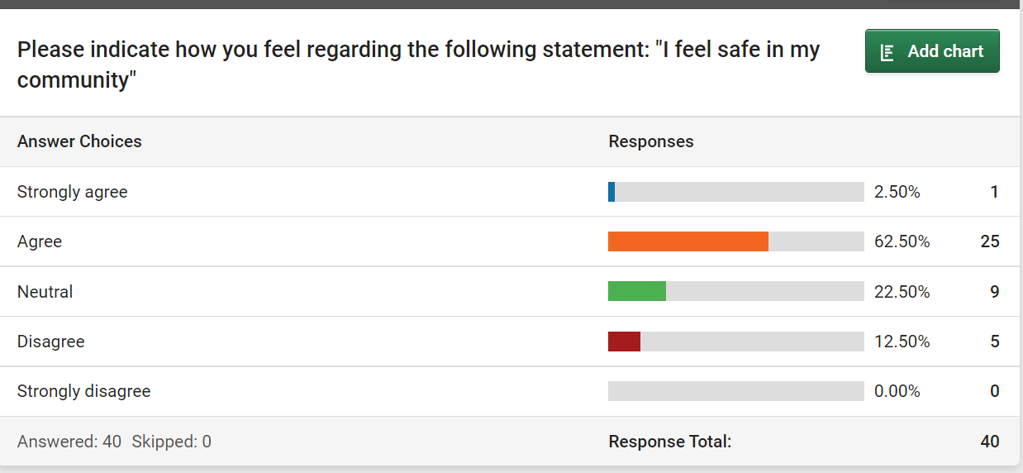
Chessington Smart Survey Results

Slide 14
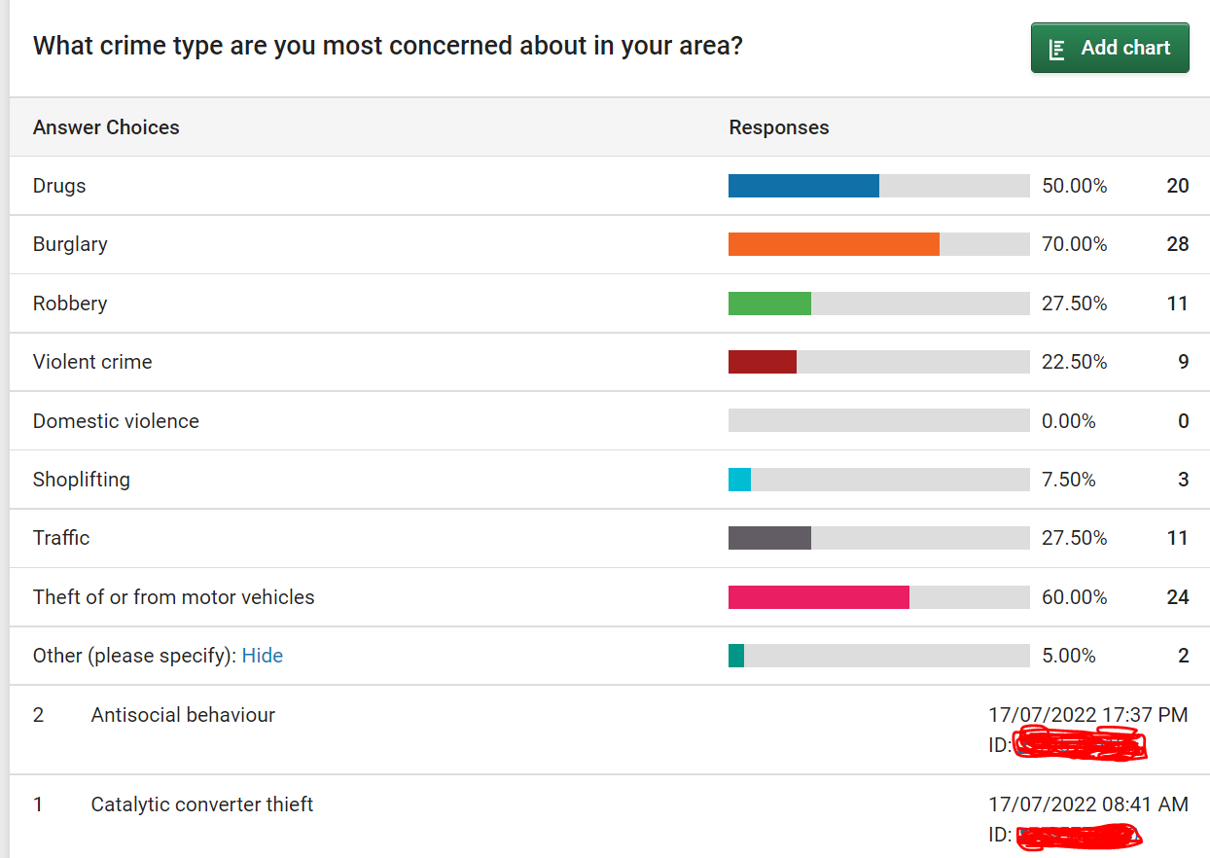
Chessington Smart Survey Results

Slide 15
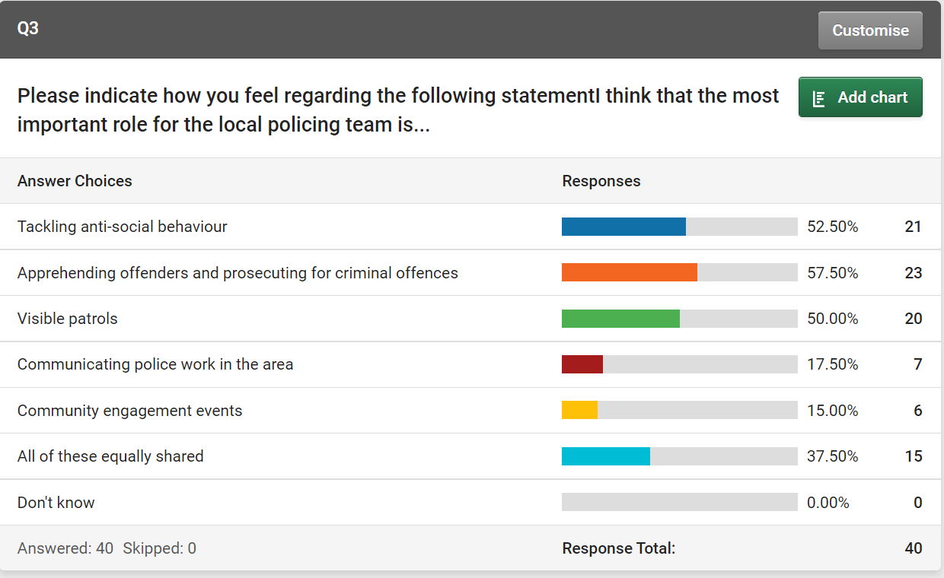
Chessington Smart Survey Results

Slide 16
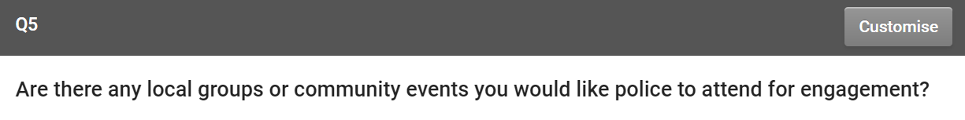
Chessington Smart Survey Results
"Not sure of local community events but think more needs to be done in terms of education and presenting to local schools the danger of drugs and the destructive nature of ant-social behaviour"
"Brownies etc"
"Visible attendance along routes that pupils from senior schools use to go home"
"Residents Association Meetings Walk around well populated sites such as Chessington Garden Centre shopping parades Hook - North Parade at busy times (owners permission and information as to best times)"
"As I am housebound and don't get out much Ny such meetings would have to be held at ChRles Lesser House Sheltered Housing community"

Slide 17
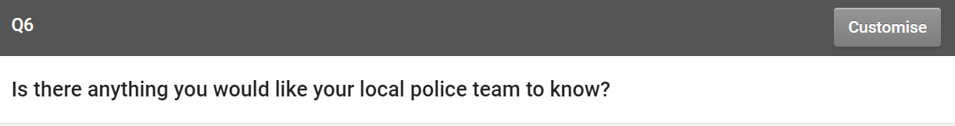
Chessington Smart Survey Results
There is just too much open abuse of smoking Cannabis in the area. Lots of teenagers meet and smoke in public places. I'm also concerned by the number of youngsters using electric scooters on roads and public parks - they are a real nuisance to children and dog-walkers using public pathways and the youngsters using them have no concept of the Highway Code. They are an "accident waiting to happen"
Thank you for attending the Chessington Fun Day - it was much appreciated.
Why can’t you be more visible on the streets
There can be issues with the local public house The Cricketers in Clayton Road. Either from the parking/noise/drugs - (sometimes). it is a 'travelling community' place. Which can be an issue when passing by or trying to get into the Close! Unsure, if there is anything that you are able to do.
We need to see positive action against the growing number of illegal e-Scooters users some them being school children to and from school , need to hear more about numbers of users (if any) being caught in the South of the Borough.
Small silver bombs that they sniff now or breath in they do this in our carpark at night and in Hereford Way and then dump all the sil errors things where we have to Lear them up

Slide 18
Smart survey – ward priorities & promises
Priorities:
(High harm) Drugs
(High volume) Burglary
Theft from motor vehicle
Our promises:
Prioritise tackling our priorities

Slide 19
Get in contact!
Hook & Chessington North
Tel: 07342 713970
Email: ChessingtonNorth@met.police.uk
Twitter: @MPSChessingtonN
Chessington South & Malden Rushett
Tel: 02087212001
Email: ChessingtonSouth@met.pollice.uk
Twitter: @MPSChessingtonS

Slide 20
Any questions?

